Slide 1
Chapter 10
Consumer Choice and Behavioral Economics
Notes:
Welcome to Economics!
Does this work?

Slide 2
Does fairness matter? (Why do people leave tips, give money to charity, etc?)
The Ultimatum Game Experiment
A given amount of money, say $20.
2 members of pair – the allocator and the recipient
The allocator decides how much of the $20 that each member of the pair gets
The recipient decides to accept the allocation (each member gets the amount decided by the allocator) or reject the allocation (each member gets nothing)

Slide 3
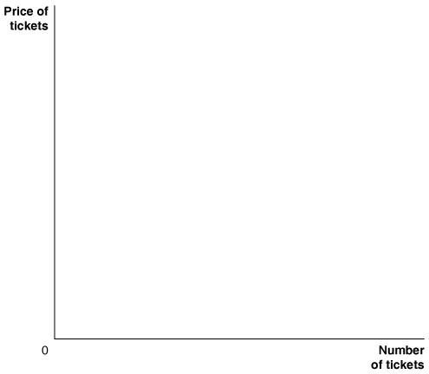
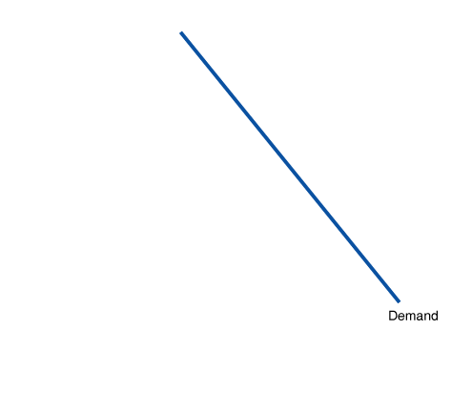
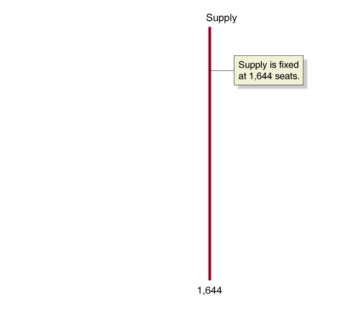
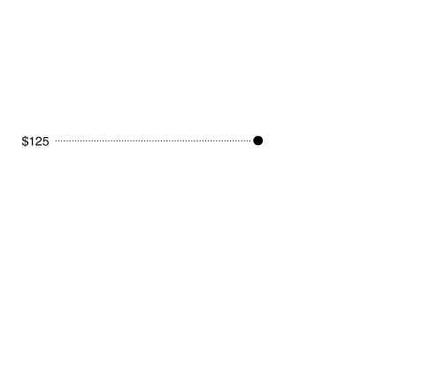
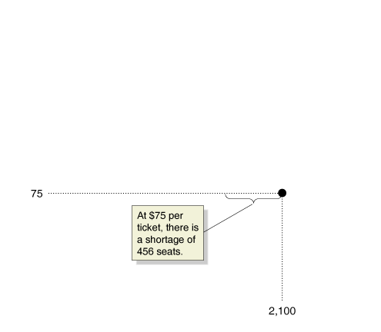
Business Implications of Fairness
The Market for Tickets to The Producers
The St. James Theater could have raised prices for the Broadway musical The Producers to $125 per ticket and still sold all of the 1,644 tickets available.
Instead, the theater kept the price of tickets at $75, even though the result was a shortage of more than 400 seats. Is it possible that this strategy maximized profits?

Slide 4
Behavioral Economics: Do People Make Their Choices Rationally?
Behavioral economics The study of situations in which people make choices that do not appear to be economically rational.
Here some of the mistakes that people commonly make when making decisions:
They take into account monetary costs but ignore nonmonetary opportunity costs.
They fail to ignore sunk costs.
They tend to overstate the probability of a certain event when faced with relatively little information.
They are unrealistic about their future behavior.

Slide 5
Irrational behavior: People often ignore nonmonetary opportunity costs
Endowment Effect: The tendency of individuals to value an item more when they own it than when they do not.
Nonmonetary opportunity costs are just as real as monetary costs and should be taken into account when making decisions.

Slide 6
Irrational behavior: Failing to ignore sunk costs
Sunk Cost is a cost that has already been paid and cannot be recovered. As such, rational decision-makers should ignore sunk costs.
You pay a non-refundable fee of $300 to join a gym for the next year. Should you consider this fee when deciding whether or not to go to the gym today?
Your company has invested 2 years of effort and $5 million researching the potential of a possible new product line. You are deciding whether or not to continue research into the potential of this product line. Should you consider the 2 years of effort and the $5 million?

Slide 7
Irrational Behavior: Over-estimating the likelihood of certain probabilistic events
The evidence is that people do not have a good intuitive understanding of probability and risk. Mistakes people make include:
Seeing patterns where there is no pattern
Overestimating the likelihood of “dramatic events” (and underestimating the likelihood of “less dramatic events”)
Overestimating recent outcomes

Slide 8
Irrational Behavior: Being unrealistic about future behavior
If you are unrealistic about your future behavior, you can underestimate the costs of choices that you make today.

